Slide 1

COMP 520 - Compilers
Lecture 18 – Abstract Syntax Trees, Why??

Slide 2
Reminders
Midterm 2 on Thursday, 4/11
Make sure you have some experience in PA4
COMP 520: Compilers – S. Ali

Slide 3
Announcements
I have finished reading all PA3 submissions done by Sunday night (keep working if you’re not done).
This lecture is targeted towards making sure we all understand the power of ASTs.
COMP 520: Compilers – S. Ali

Slide 4
Announcements (2)
A small portion of you maximized AST potential.
A good portion nearly maximized their potential, and a good portion had a lot of redundant code.
Today we uncover the secrets of ASTs.
COMP 520: Compilers – S. Ali

Slide 5
Why are we using ASTs?
Is it just some arbitrary decision that is just
“one way to do Compilers”?
COMP 520: Compilers – S. Ali

Slide 6
Why are we using ASTs?
Is it just some arbitrary decision that is just “one way to do Compilers”?
Yes and no. Yes it is, but it makes life easier for us. No, it will make life harder for you otherwise, so we should learn ASTs.
  Examples of “no”: bogo sort
(Note: with some language exceptions, ASTs can look vastly different, but the core concept remains the same).
Today’s question: did ASTs make our lives easier?
COMP 520: Compilers – S. Ali

Slide 7
Visitor Model
A quick review
COMP 520: Compilers – S. Ali

Slide 8
AST
public abstract class AST {
public abstract <A,R> R visit(Visitor<A,R> v, A o);
}
This is an abstract class.
This method is not defined.
COMP 520: Compilers – S. Ali

Slide 9
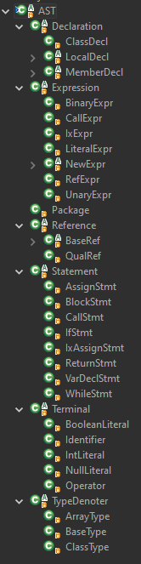
AST (2)
public abstract class AST {
public abstract <A,R> R visit(Visitor<A,R> v, A o);
}
Visit is defined in concrete classes:
COMP 520: Compilers – S. Ali

Slide 10
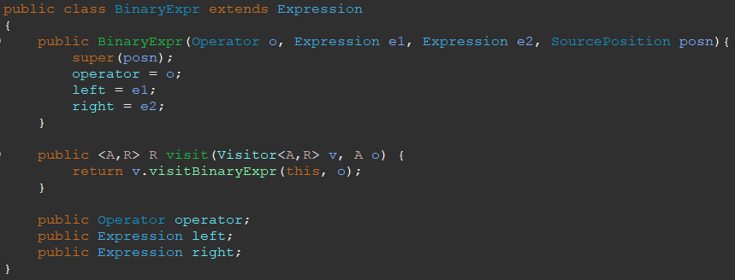
Concrete Visit Method
Let’s build the framework to see this in action.
COMP 520: Compilers – S. Ali

Slide 11
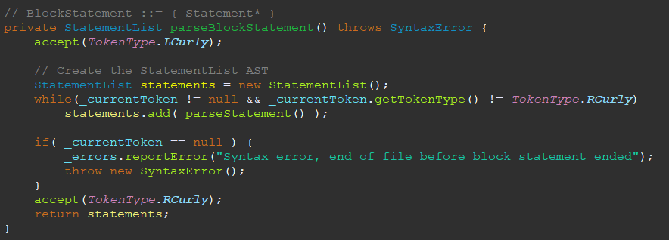
Recall Creating Statement Lists
“So long as input isn’t a }, keep giving me an abstract Statement
object returned by parseStatement();”
COMP 520: Compilers – S. Ali

Slide 12
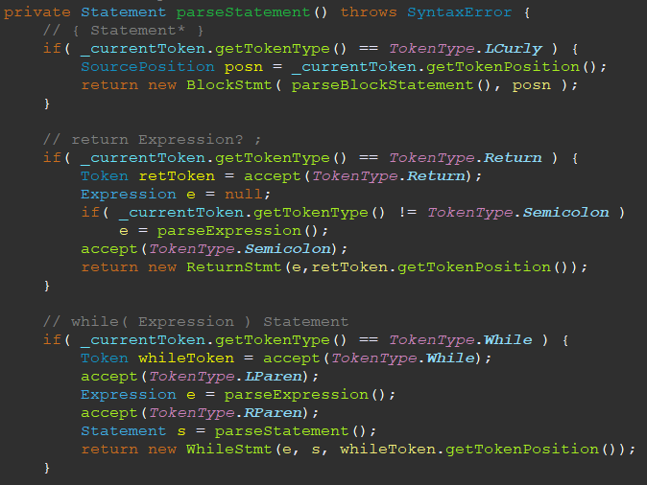
A peek into parseStatement
“This method will return a Statement.
What kind of statement? No idea!”
BlockStmt, which extends Statement
and has a defined visit method.
ReturnStmt, which extends Statement
and has a defined visit method.
WhileStmt, which extends Statement
and has a defined visit method.
COMP 520: Compilers – S. Ali

Slide 13
A peek into visitStatement (2)
“This method will return a Statement.
What kind of statement? No idea!”
BlockStmt, which extends Statement
and has a defined visit method.
ReturnStmt, which extends Statement
and has a defined visit method.
WhileStmt, which extends Statement
and has a defined visit method.
COMP 520: Compilers – S. Ali

Slide 14

Calling an Abstract Method
ME=Identification
“I don’t know what type this Statement “s” is, but I know
it was instantiated with a REAL visit method”
Why?
COMP 520: Compilers – S. Ali

Slide 15
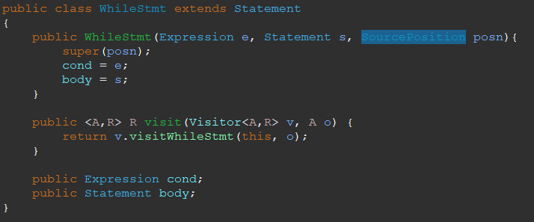
Calling an Abstract Method (2)
“During runtime, the visit method maps here
for this particular example Statement”
(Afterall, it had to be instantiated somehow)
“Statement is WhileStmt”
COMP 520: Compilers – S. Ali

Slide 16
Calling an Abstract Method (3)
Parameter and Argument. When visiting,
the first parameter is always “this”
COMP 520: Compilers – S. Ali

Slide 17
Calling an Abstract Method (4)
So this WhileStmt’s visit method just calls
the CALLER’s visitWhileStmt method.
COMP 520: Compilers – S. Ali

Slide 18
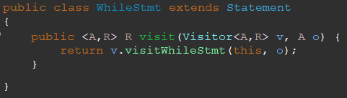
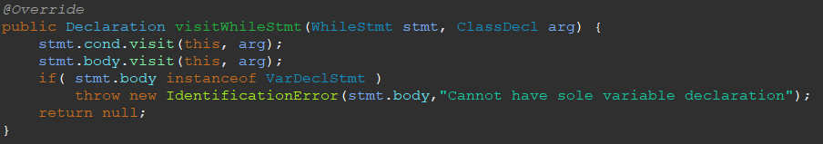
Calling an Abstract Method (5)
ME
This means, s.visit(…) code is equivalent to:
if( s instanceof WhileStmt )
visitWhileStmt( s, arg );
… … …
“Call MY
visitWhileStmt”
COMP 520: Compilers – S. Ali

Slide 19
PA2 - ASTs
In case you forgot, you instantiated the concrete classes in PA2 in your parser.
So when you instantiated a concrete “VardeclStmt”, you specified “if you visit this Statement, make sure you pair it with ‘visitVarDeclStmt’ for whoever the visitor is.”
COMP 520: Compilers – S. Ali

Slide 20
The Terrifying, Terrific, Tantalizing, Tormenting Truth of ASTs
Elegantly combine parsing and input code traversal.
COMP 520: Compilers – S. Ali

Slide 21
Identification
Consider wanting to implement this:
visitIdentifier( Identifier id, String ctx ) ::=
id.decl = findDeclaration( ctx, id );
return id.decl;
(It won’t know the context, needs it to be passed in)
COMP 520: Compilers – S. Ali

Slide 22
Package…
Package contains: ClassDeclList, which is just a list of ClassDecls
Parser: parseClassDecl- Returns a ClassDecl.
Add each ClassDecl into our list
COMP 520: Compilers – S. Ali

Slide 23

ClassDecl
Contains a FieldDeclList (member variables) and MethodDeclList (member methods)
If it was a method, you would parseStatement until out of statements, and store that in the MethodDecl.
COMP 520: Compilers – S. Ali

Slide 24
Visiting a Method
Thus, when you visit the Statements in a MethodDecl, you visit the Statement objects that you instantiated in PA2.
Those statements contained Expressions that you also created in PA2.
COMP 520: Compilers – S. Ali

Slide 25
The Mysteries of References
COMP 520: Compilers – S. Ali

Slide 26
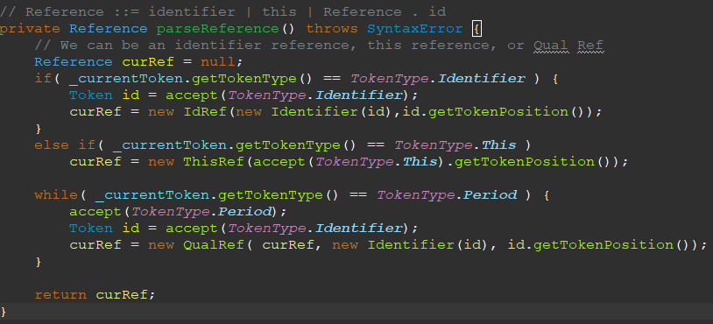
Recall: Creating References
Grammar: Reference ::= id | this | Reference . id
Improved: (this|id)(.id)*
COMP 520: Compilers – S. Ali

Slide 27

Recall: Creating References (2)
Implies: only three
types of references.
IdRef,
ThisRef,
QualRef.
Confirmed
COMP 520: Compilers – S. Ali

Slide 28
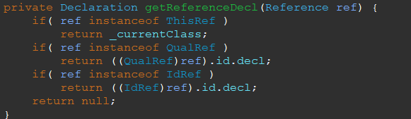
Note: If Identifiers have a Decl, then References map to a Decl too!
COMP 520: Compilers – S. Ali

Slide 29
Note: If Identifiers have a Decl, then References map to a Decl too!
Thus, references map to some memory location. See CFGs:
  Reference [ Expression ] - Reference because it must be a variable
  Reference ( ArgumentList? ) - Reference because it must be a method
  Reference = Expression ; - Reference because need to store data.
Makes sense, use references to “refer to something” whereas expressions need to be evaluated.
COMP 520: Compilers – S. Ali

Slide 30
Parsing VS Grammar
Grammar:
  Reference ::= id | this | Reference . id
Parsing:
  Reference ::= (this|id)(.id)*
Parsing is misleading!
COMP 520: Compilers – S. Ali

Slide 31
Parsing VS Grammar (2)
Grammar:
  Original: Reference ::= id | this | Reference . id
  Try this: QualRef ::= (ThisRef|IdRef)(.id)+
  Useful to view them as AST grammars instead!
  Question: What is the only repeating component?
COMP 520: Compilers – S. Ali

Slide 32
Parsing VS Grammar (3)
Grammar:
  Reference ::= id | this | Reference . id
  Try this: QualRef ::= (ThisRef|IdRef)(.id)+
  The only repeating element is identifiers.
AST Example:
IdRef . Identifier . Identifier . Identifier
COMP 520: Compilers – S. Ali

Slide 33
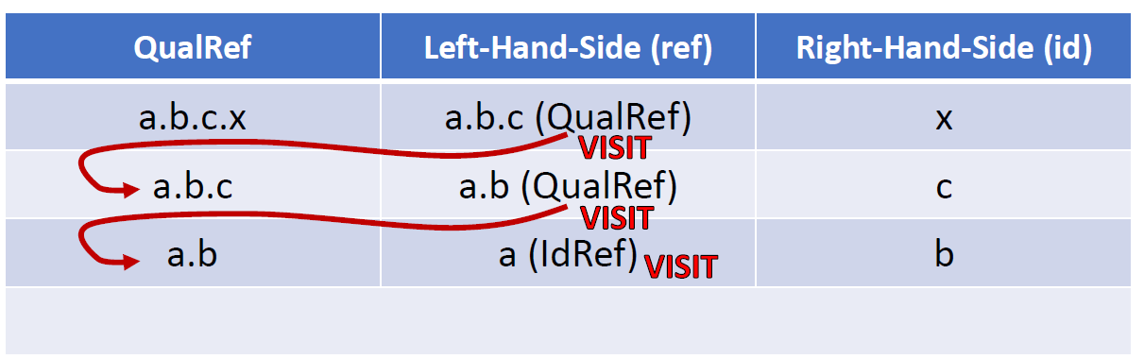
IdRef
Thus, if you visit an IdRef, Then it was either a plain “id” used as a reference, or the left-most identifier in a QualRef.
THEREFORE: visitIdRef is ALWAYS in the context of the current class.
COMP 520: Compilers – S. Ali

Slide 34
IdRef (2)
Thus, if you visit an IdRef, Then it was either a plain “id” used as a reference, or the left-most identifier in a QualRef.
THEREFORE: visitIdRef is ALWAYS in the context of the current class.
And the implementation for PA3 is…
visitIdRef ::=
ref.id.visit( this, currentClassName );
// (CTX is currentClass)
COMP 520: Compilers – S. Ali

Slide 35
IdRef (Recall visitIdentifier)
visitIdRef ::=
ref.id.visit( this, currentClassName );
… // Do checks for non-static in static method
visitIdentifier( Identifier id, String ctx ) ::=
id.decl = findDeclaration( ctx, id );
Question: do I need a private check here?
COMP 520: Compilers – S. Ali

Slide 36
The mysteries of RefExpr
COMP 520: Compilers – S. Ali

Slide 37
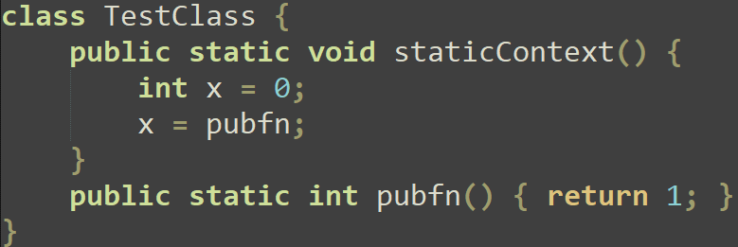
Recall Fail351.java
Method, not
variable.
COMP 520: Compilers – S. Ali

Slide 38
Recall: CallExpr / CallStmt
Grammar:
  CallStmt ::= Reference ( ArgumentList? ) ;
  CallExpr ::= Reference ( ArgumentList? ) ;
  RefExpr ::= Reference ;
COMP 520: Compilers – S. Ali

Slide 39
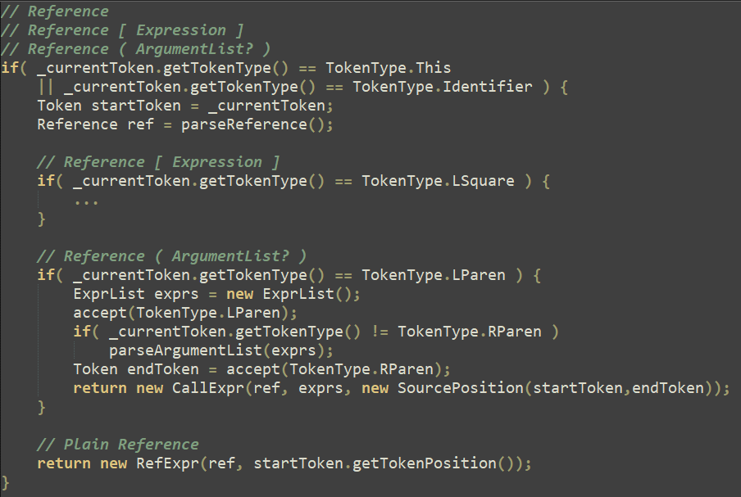
You did this in PA2
Instantiate a CallExpr vs RefExpr
COMP 520: Compilers – S. Ali

Slide 40
You did this in PA2 (2)
DISJOINT
CASES
COMP 520: Compilers – S. Ali

Slide 41
Thus, PA3 check becomes easier.
If it is a RefExpr, then it is not a CallExpr.
Therefore, visitRefExpr, if the reference’s declaration is a MethodDecl, then it is wrong.
  E.g. x = someFn; instead of x = someFn();
In a CallExpr, if the reference’s declaration is NOT a MethodDecl, then it is wrong.
  E.g. int x = 0; int y = 0; y = x();
COMP 520: Compilers – S. Ali

Slide 42
The mysteries of QualRef
COMP 520: Compilers – S. Ali

Slide 43
Figuring out QualRef
Left-hand-side | Returned Declaration after a Visit | Notes | Notes 2
Identifier: “CLASSNAME” | Declaration: ClassDecl | RHS must be a static ?? | If the RHS is declared in a different class, RHS cannot be private.
Identifier: “this” | Declaration: ClassDecl | RHS must be a ??
Identifier: “NAME” (not a class) | Declaration: MemberDecl or LocalDecl | RHS must be a ??
First question: An identifier
on the RHS of a QualRef is
at what level of SI?
COMP 520: Compilers – S. Ali

Slide 44
Figuring out QualRef
Left-hand-side | Returned Declaration after a Visit | Notes | Notes 2
Identifier: “CLASSNAME” | Declaration: ClassDecl | RHS must be a static MemberDecl | If the RHS is declared in a different class, RHS cannot be private.
Identifier: “this” | Declaration: ClassDecl | RHS must be a MemberDecl
Identifier: “NAME” (not a class) | Declaration: MemberDecl or LocalDecl | RHS must be a MemberDecl
COMP 520: Compilers – S. Ali

Slide 45
Figuring out QualRef
Left-hand-side | Returned Declaration after a Visit | Notes | Notes 2
Identifier: “CLASSNAME” IdRef / Id | Declaration: ClassDecl | RHS must be a static MemberDecl | If the RHS is declared in a different class, RHS cannot be private.
Identifier: “this” ThisRef | Declaration: ClassDecl | RHS must be a MemberDecl
Identifier: “NAME” (not a class) | Declaration: MemberDecl or LocalDecl | RHS must be a MemberDecl
Translate this table into code. (Cleanup required)
1) If LHS.decl instanceof ClassDecl, then RHS must be static
unless LHS instanceof ThisRef
2) Resolve RHS in the context of LHS
2a) If LHS.decl is ClassDecl, easy, ctx is that class’s name
2b) If LHS.decl is MemberDecl, get that member’s classname
2c) If LHS.decl is LocalDecl, easy, ctx is that class type’s name.
3) RHS.decl is always instanceof MemberDecl
Additional checks:
4) LHS cannot be a MethodDecl (miniJava shortcut)
5) If RHS is private, check if current class name equals their class
6) LHS must be a ClassType (classes have fields, everything else does not) if it isn’t a ThisRef.
6a) Thus, visit the ClassType to get the ClassDecl of the LHS.
COMP 520: Compilers – S. Ali

Slide 46
How does this help in PA3?
COMP 520: Compilers – S. Ali

Slide 47
PA3 Summarized
Make Stack<HashMap<String,Declaration>> SI;
Create level 0 and 1 immediately
Forcibly inject predefined names into level 0 and 1
  Level 0: String, _Printstream, System
  Level 1: _Printstream.println, System.out\
COMP 520: Compilers – S. Ali

Slide 48
PA3 Summarized (2)
Forcibly inject all Classes and Fields into level 0 and 1
  Is this class name used at level 0? Error, or add the class name to level 0.
  Is this field name used at level 1? Error, or add the name to level 1 (with context).
Begin visiting classes
Why?
Why?
COMP 520: Compilers – S. Ali

Slide 49
PA3 Summarized (3)
Begin visiting classes.
Visit everything (e.g. visitArrayType visits the element type, and MethodDecl visits internal Statements, etc.)
  visitClassDecl: Name already added, just visit methods.
  visitMethodDecl: Name already added, just visit statements.
  visitParameterDecl: Does it already exist at level 2+?
Why?
COMP 520: Compilers – S. Ali

Slide 50
PA3 Summarized (4)
  visitClassType: The identifier better be a class name!
    Why?
  visitBaseType: do nothing.
    Why?
  visitArrayType: visit the element type.
    Why?
COMP 520: Compilers – S. Ali

Slide 51
PA3 Summarized (5)
  visitVarDecl: Does the name exist at 2+?
    Question: How can I only check 2+?
    Error or add at top scope level
  visitCallStmt: Just to reiterate as an example, visit all of
  the expressions in the Call (visit everything!).
  Visit the Reference too, and that reference better be
  have a methodDecl.
COMP 520: Compilers – S. Ali

Slide 52
PA3 Summarized (6)
  visitThisRef: Return “CurrentClassDecl”
    How can we keep track of the currentClassDecl?
  visitIdRef: Are we in a static method? If so and if the
  decl is a MemberDecl (level 1), make sure the IdRef’s
  identifier’s declaration is static and not currently being
  declared. (IdRef means access local class fields or locals)
COMP 520: Compilers – S. Ali

Slide 53
PA3 Summarized (7)
  visitRefExpr: A reference expression (keyword: expression) cannot just have a reference be a class name.
    Is the reference.decl a ClassDecl (and ref not instanceof ThisRef), then error. (E.g. x = CLASSNAME;)
    Similarly, RefExpr cannot be a MethodDecl, otherwise it should have been a CallExpr not RefExpr.
      E.g., x = method; vs x = method();
  visitCallExpr: Like CallStmt.
  visitQRef: Do Slide 44 check.
  Etc.
COMP 520: Compilers – S. Ali

Slide 54
PA3 Type-Checking
Every useful node returns a TypeDenoter.
Two types of type-checks:
  Are these two types the same?
  Given two types and an operator, what is the result type?
Example: At every visit method, ask,
“What needs to be ensured here?
What MUST be a ClassType?
What MUST be an ArrayType (IxExpr)?
What MUST be the same type (AssignStmt)?”
COMP 520: Compilers – S. Ali

Slide 55
Midterm 2 Review
COMP 520: Compilers – S. Ali

Slide 56
Midterm 2 is shorter
Because of delays, it doesn’t make sense to have a full midterm this late in the semester.
Instead, we made the midterm shorter by a question (and arguably easier).
Your main goals should be to learn PA4, which is worth more than the midterm.
COMP 520: Compilers – S. Ali

Slide 57
Optimization
Dataflow / Codeflow analysis is not on the midterm.
Key takeaway from optimization:
  You don’t need to respect the input code, can generate more optimized code.
COMP 520: Compilers – S. Ali

Slide 58
Byte Encoding / ModRMSIB
You already learned how to do this in earlier prerequisite classes.
  PA4 is new because of CISC, but it isn’t Midterm-worthy.
Don’t worry about encoding bytes.
COMP 520: Compilers – S. Ali

Slide 59
What should you know?
How to generate “equivalent” code
How to do identification and type-checking
Midterm is cumulative with PA1 and PA2
You should have some general mastery over what you have done on your compiler project
COMP 520: Compilers – S. Ali

Slide 60
Side notes about PA4
If “int is 4 bytes” is giving you trouble, just make everything 8 bytes and fix it later.
Some PA4 starter files have “TODO” marked but won’t flag a compiler error. Easiest way to handle this:
Find the word “TODO” in the starter files.
COMP 520: Compilers – S. Ali

Slide 61
Feedback I’ve gotten thus far
“I’m trying to compile a simple println program and that is dope”
  Response: just imagine what it will be like when it is fully functional! (Imagine the stuff you can do with the compiler too)
“A lot of the code isn’t mine, how can I attribute this?”
  Response: the starter code is boring, you are implementing the more interesting stuff. Imagine adding a ton of line breaks and claiming you do a lot of LOCs.
  YOU control the interesting parts.
COMP 520: Compilers – S. Ali

Slide 62
Questions?
Let’s go over how the midterm is used
Let’s go over the cheat sheet
COMP 520: Compilers – S. Ali

Slide 63
End

Slide 64
COMP 520: Compilers – S. Ali

Slide 65
COMP 520: Compilers – S. Ali

Slide 66
COMP 520: Compilers – S. Ali

Slide 67
COMP 520: Compilers – S. Ali

